Slide 1
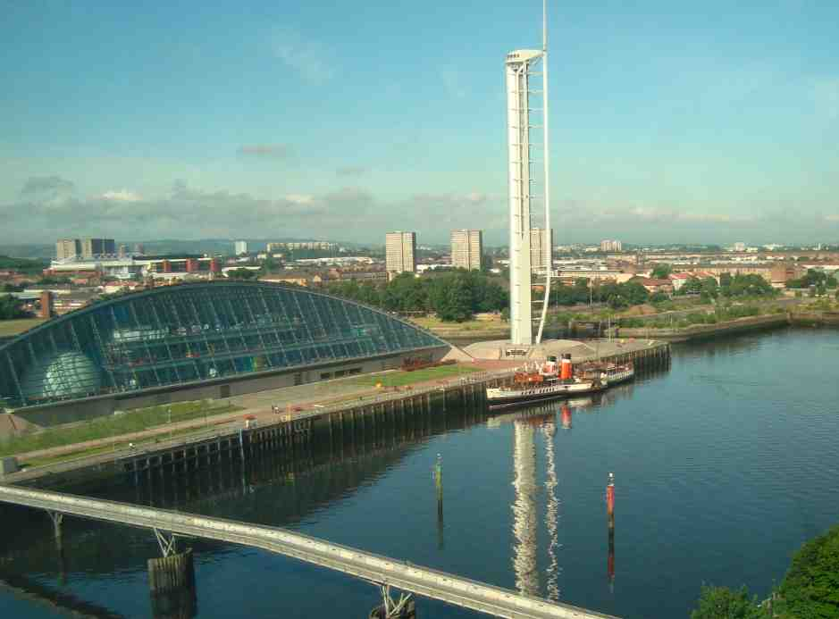
Higher Maths
Revision Notes
Basic Differentiation
goodbye
Get Started

Slide 2

Basic differentiation
You should know the meaning of the terms limit, differentiable at a point,
differentiate, derivative, differentiable over an interval, derived function.
Differentiate a function whose terms are of the form ax^{n}
find the gradient of the tangent to a curve y = f(x) at x = a
the rate of change of f at a
sketch a curve with given equation
Find where the function
f is strictly increasing,
decreasing or stationary.
determine the greatest/least values of a function on a given interval
solve optimisation problems using calculus
find the stationary point(s) (values) on a curve and determine their nature using differentiation

Slide 3
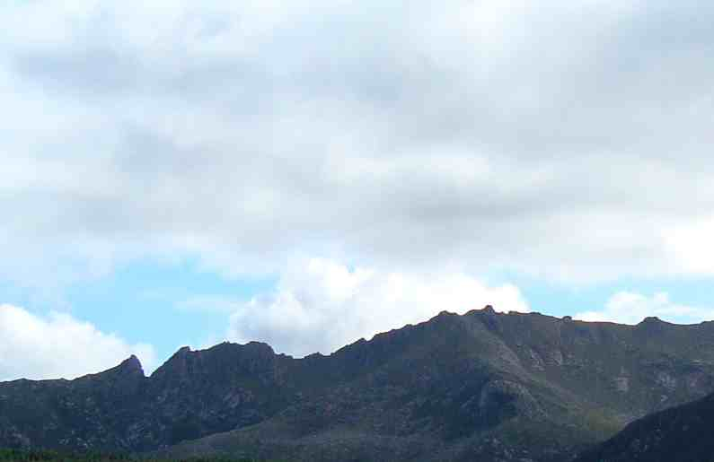
Rule of thumb:
Multiply by the power and reduce the power by 1.
Examples
Test
Yourself?

Slide 4
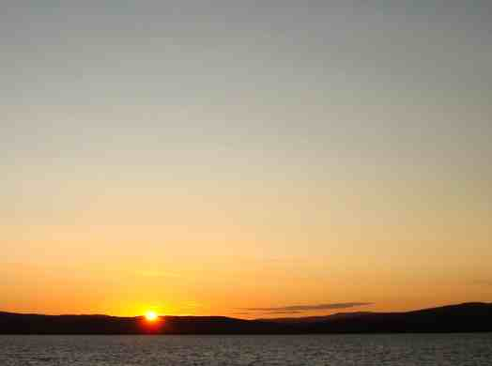
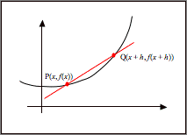
A straight line has a gradient
The chord PQ has a gradient
As h tends to zero, Q tends towards P and the chord PQ becomes the tangent at P.
The gradient of the tangent at P =
Example
Find the gradient of the tangent to the curve y = 3x² + 2x – 1 at the point P(1, 4)
To find the gradient of the tangent to the curve y = f(x) at x = a we need to evaluate f ´(a).
Test
Yourself?
Thus gradient at P is 26.

Slide 5
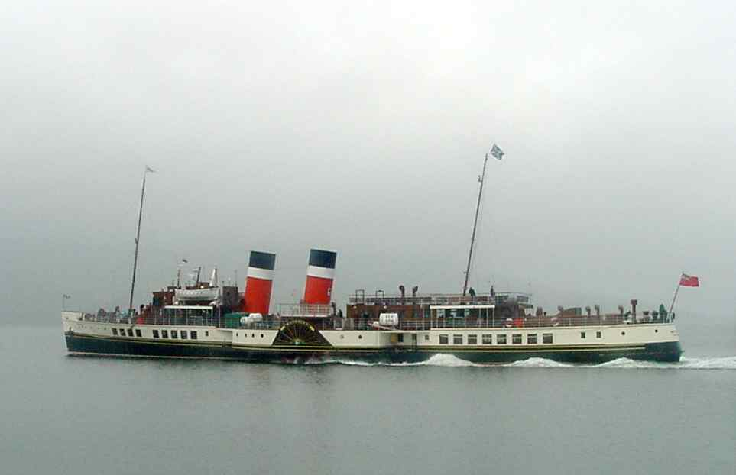
The Waverley can reach its top speed in 5 minutes.
During that time its distance from the start can be
calculated using the formula D = t + 50t²
where t is the time in minutes and D is measured in metres.
What is the Waverley’s top speed?
Speed, v m/min, is the rate of change of distance with time.
v = 1 + 100 × 5 = 501 m/sec
How fast is it accelerating?
Acceleration, a m/min/min, is the rate of change of speed with time.
Test
Yourself?

Slide 6
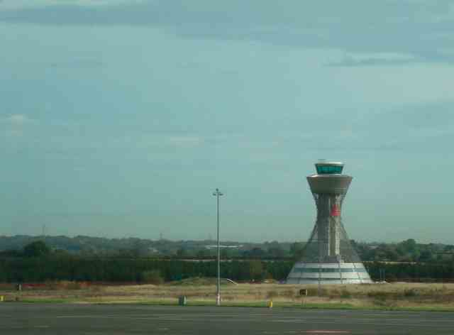
y
The signs indicate where the gradient of the curve is:
positive … the function is increasing
negative … the function is decreasing
zero … the function is stationary
0
+
–
+
–
–
0
+
–
+
O
–
x
A function is strictly increasing in a region where f´(x) > 0
A function is strictly increasing in a region where f´(x) < 0
A function is stationary where f´(x) = 0
Example
f(x) = 2x³ – 3x² – 12x + 1.
Identify where it is (i) increasing (ii) decreasing (iii) stationery
A sketch of the derivative shows us that
f´(x) < 0 for 0 < x < 2 … f(x) decreasing
f´(x) > 0 for x < 0 or x > 2 … f(x) increasing
f´(x) = 0 for x = 0 or x = 2 … f(x) stationary
Test
Yourself?

Slide 7
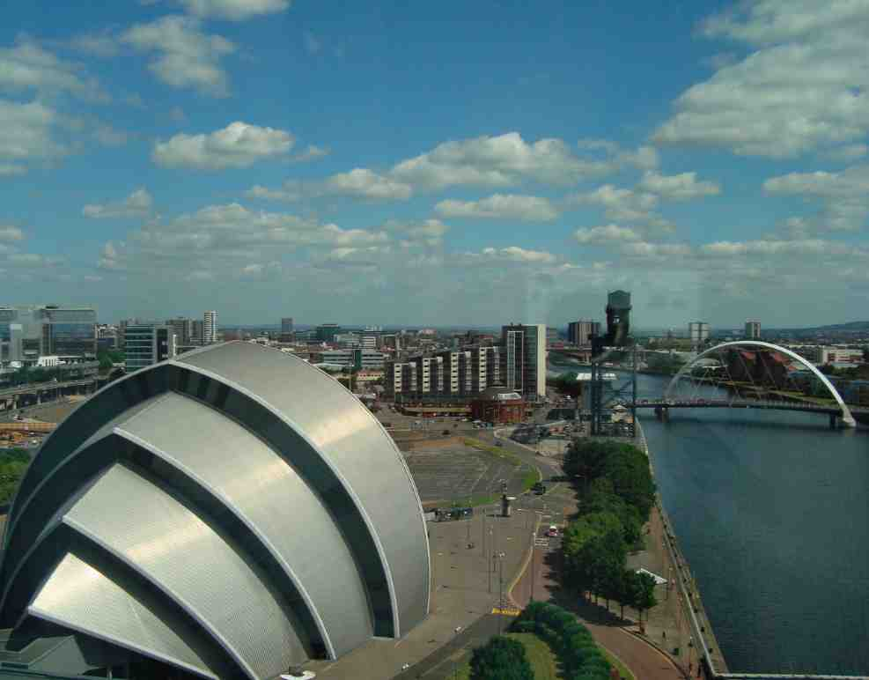
To sketch a curve, collect the following information:
• where will it cut the y-axis? [x = 0]
• where will it cut the x-axis? [f(x) = 0]
• where is it stationary? [f ´(x) = 0]
• where is f(x) increasing/decreasing [f ´(x) > 0/ f ´(x) < 0]
especially in the neighbourhood of the stationary points.
• how does f(x) behave as x → ±∞
Test
Yourself?

Slide 8
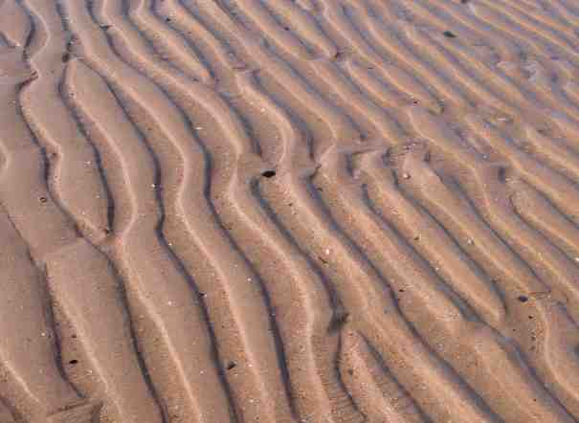

When a function is defined on a closed interval, a ≤ x ≤ b, then it must have a maximum and a minimum value in that interval.
These values can be found either at
• a stationary point [where f´(x) = 0]
• an end-point of the closed interval. [f(a) and f(b)]
All you need do is find these values and pick out the greatest and least values.
Example
A manufacturer is making a can to hold 250 ml of juice.
The cost of the can is dependent on its radius, x cm.
For practical reasons the radius must be between 2·5 cm and 4·5 cm.
The cost can be calculated from the formula
C = x³ –5x² + 3x + 15, 2·5 ≤ x ≤ 4·5.
Calculate the maximum and minimum values of the cost function.
… which equals zero at stationary points.
3x² – 10x + 3 = 0
(3x– 1)(x – 3) = 0
x = ¹/₃ or x = 3
Working to 1 d.p.
f(¹/₃) = 15·5
f(3) = 6
f(2·5) = 6·9
f(4·5) = 18·4
By inspection f_{max} = 18·4 (when x = 4·5) and f_{min} = 6 (when x = 3).
Test
Yourself?

Slide 9

solving optimisation problems using calculus
Example
A box has a square base of side x cm and a height of h cm.
It has a volume of 1 litre (1000 cm³)
For what value of x will the surface area of the box be minimised?
[… and hence the cost of production be optimised]
h
x
x
To use calculus we must express the surface area in terms of x alone … so we must find h in terms of x .
For a cuboid, volume = lbh … so in this case 1000 = x²h.
And so,
The box is made from 6 rectangles, two of area x² cm² and four of area xh cm²
Total Surface Area, S = 2x² + 4xh
S = 2x² + 4000x^{–1}
If x < 10, 4x < 40 and 4000x^{–2} > 40
So ^{dS}/_{dx} < 0 … a decreasing function
If x > 10, 4x > 40 and 4000x^{–2} < 40
So ^{dS}/_{dx} > 0 … an increasing function
Decreasing before x = 10 and increasing after it
Gives us a minimum turning point.
= 0 at stationary points
4x = 4000x^{–2}
x³ = 1000
x = 10
Test
Yourself?
If x = 10 then h = 10.
A cube of side 10 cm has a volume of 1000 cm³ and the smallest possible surface area.

Slide 10
Example
Find the stationary points of the function f(x) = x⁵ + 5x⁴ – 35x³ + 1 and determine their nature.
Differentiate: f´(x) = 5x⁴ + 20x³ – 105x²
Equate to zero: 5x⁴ + 20x³ – 105x² = 0 at stationary points
(factorise) ⇒ 5x²(x² + 4x – 21) = 0
⇒ 5x²(x – 3)(x + 7) = 0
⇒ x = 0 (twice), x = 3 or x = –7
Make a table of signs:
… scan the critical x’s
… examine each factor of dy/dx
… conclusions based on sign of derivative
Stationary points occur at
x = –7 ( a maximum turning point);
x = 0 (a horizontal point of inflexion);
x = 3( a minimum turning point.
The corresponding stationary values are
f(–7) = 7204
f(0) = 1
f(3) = –296
The stationary points are: (–7, 7204) a max TP; (0, 1) a horizontal PI; (3, –296) a min TP
Test
Yourself?

Slide 11
Differentiate
3x⁵ + 4x³ – x – 3
3x² + 2√x
(c)
(d)
reveal

Slide 12
Differentiate
3x⁵ + 4x³ – x – 3
3x² + 2√x
(c)
(d)
(a) 15x⁴ + 12x² –1
(b)
You must make each term take the shape ax^{n}
(c)
(d)

Slide 13
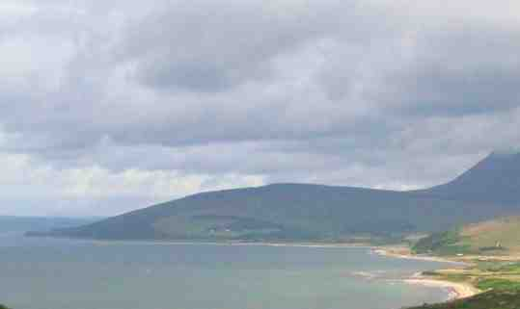
Gradient at a Point
reveal
Using convenient units and axes, the profile of a hill has been modelled by
H = 0·1(x³ – 5x² + 6x) where H is the height and x is the distance from the origin.
What is the gradient of the curve when x = 2?

Slide 14
Gradient at a Point
H = 0·1x³ – 0·5x² + 0·6x
Using convenient units and axes, the profile of a hill has been modelled by
H = 0·1(x³ – 5x² + 6x) where H is the height and x is the distance from the origin.
What is the gradient of the curve when x = 2?

Slide 15
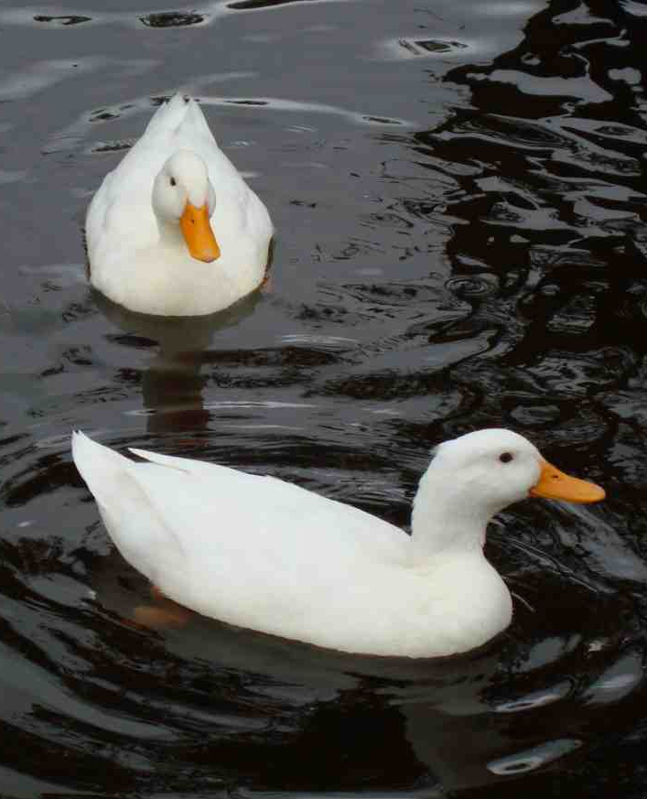
Rates of change
reveal
The radius, r cm, of a particular circular ripple is related to the time, t, in seconds since the photo was taken.
r = 4t + 3
How fast is the area of the circle growing when the radius is 10 cm?

Slide 16
Rates of change
Since r = 4t + 3
then r = 11 ⇒ t = 2.
and the area of the circular ripple, A cm², is π(4t + 3)²
A = π(4t + 3)²
⇒ A = 16πt² + 24πt + 9π
The radius, r cm, of a particular circular ripple is related to the time, t, in seconds since the photo was taken.
r = 4t + 3
How fast is the area of the circle growing when the radius is 11 cm?
When the radius is 11 cm, the area is increasing at the rate of 276·5 cm² per second
correct to 1 d.p.

Slide 17
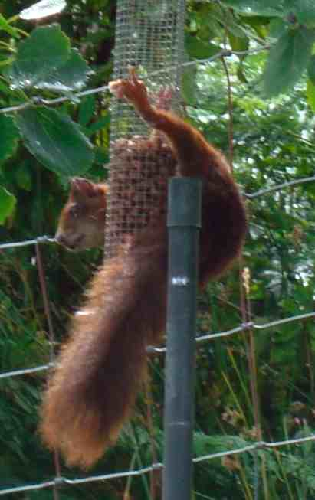
Increasing/decreasing functions
reveal
During one study of red squirrels
the number in one area was modelled
by the function
N(x) = x³ – 15x² + 63x – 10, 1 < x < 12
Where x is the number of years since the
study started.
During what years was this a decreasing function?

Slide 18
Increasing/decreasing functions
N(x) = x³ – 15x² + 63x – 10, 1 < x < 12
N´(x) = 3x² – 30x + 63
N´(x) = 0 at stationary points
3x² – 30x + 63 = 0 ⇒ x = 3 or 7
N´(x)
During one study of red squirrels
the number in one area was modelled
by the function
N(x) = x³ – 15x² + 63x – 10, 1 < x < 12
Where x is the number of years since the
study started.
During what years was this a decreasing function?
7
x
3
The sketch shows that N´(x) < 0 for 3 < x < 7.
The population was on the decrease between the 3rd and 7th years of the survey.

Slide 19
Curve sketching
Sketch the curve with equation
y = x³ – 5x² – 8x + 12
Identifying
where will it cut the y-axis?
where will it cut the x-axis?
where is it stationary?
where it is increasing/decreasing
especially in the neighbourhood of the stationary points.
(v) how it behave as x → ±∞
reveal

Slide 20
Curve sketching
x = 0 ⇒ y = 12 … (0, 12)
y = 0 ⇒ x³ – 5x² – 8x + 12 = 0
⇒ (x – 1)(x + 2)(x – 6) = 0
x = 1 or x = –2 or x = 6 … (1, 0), (–2,0),(6, 0)
^{dy}/_{dx} = 3x² – 10x – 8
= 0 at S.P.s
3x² – 10x – 8 = 0 ⇒ (3x + 2)(x – 4) = 0
⇒ x = –²/₃ or x = 4 … a max TP at (–²/₃ , ⁴⁰⁰/₂₇ )
⇒ y = ⁴⁰⁰/₂₇ or y = –36 … a min at (4 , –36 )
Sketch the curve with equation
y = x³ – 5x² – 8x + 12
Identifying
where will it cut the y-axis?
where will it cut the x-axis?
where is it stationary?
where it is increasing/decreasing
especially in the neighbourhood of the stationary points.
(v) how it behave as x → ±∞
(iv)
(v) When x is large and positive, y is large and positive (1st quad)
When x is large and negative, y is large and negative (3rd quad)

Slide 21

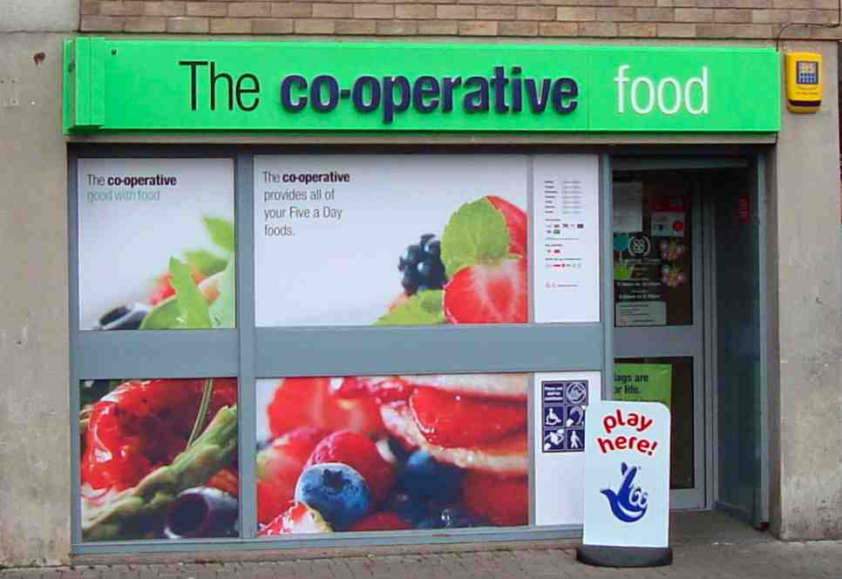
A shop takes x deliveries a year of cereal.
The suppliers are willing to make between 20 and 200 deliveries a year.
The annual cost of these deliveries can be calculated from the formula:
reveal
; 20 ≤ x ≤ 200
Calculate the number of deliveries that will minimise the costs.

Slide 22
Find stationary point(s)
At stationary points C´(x) = 0
A shop takes x deliveries a year of cereal.
The suppliers are willing to make between 20 and 200 deliveries a year.
The annual cost of these deliveries can be calculated from the formula:
Examine end-points and stationary point(s)
; 20 ≤ x ≤ 200
What is the manager’s best strategy to minimise the costs.
Optimum strategy: Order 50 times a year. This will minimise costs at £400.

Slide 23
Optimisation
30 cm
20 cm
x
20 – 2x
x
30 – 2x
reveal
An A4 sheet of paper, roughly 20 by 30 cm
has its edges folded up to create a tray.
Each crease is x cm from the edge.
What size should x be in order to maximise the volume of the tray?

Slide 24
Optimisation
30 cm
Express volume in terms of x:
V = x(20 –2x)(30 –2x)
= 4x³ – 100x² + 600x
20 cm
x
Differentiate
20 – 2x
x
= 0 at S.P.s
30 – 2x
An A4 sheet of paper, roughly 20 by 30 cm
has its edges folded up to create a tray.
Each crease is x cm from the edge.
What size should x be in order to maximise the volume of the tray?
Check nature
Conclusion
When x = 3·9, the volume is at a maximum of 1056 cm³.

Slide 25
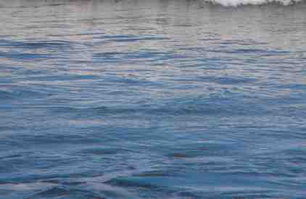
Stationary points and nature
A function is defined by
Show that its derivative has factors
x, (x + 1) and (x – 1)
(b) Find the stationary points of the function and determine their nature.
reveal

Slide 26
Stationary points and nature
differentiate
A function is defined by
Equate to zero
At S.Ps f´(x) = 0
i.e. x = 0 or x = –1 or x = 1
Make nature table
Show that its derivative has factors
x, (x + 1) and (x – 1)
(b) Find the stationary points of the function and determine their nature.
Find corresponding y-values.
Summarise findings
(–1,–⁷/₆₀) point of inflexion
(1,–²³/₆₀) minimum turning point
(0, 0) minimum turning point

